Slide 1

Pocket Chef

Slide 2


Target Users
Users that these requirements could potentially originate from:
An older demographic is expected to use our app more, placing emphasis on ease of access, simplicity of design, and straightforward features that are both intuitive and well documented

Slide 3
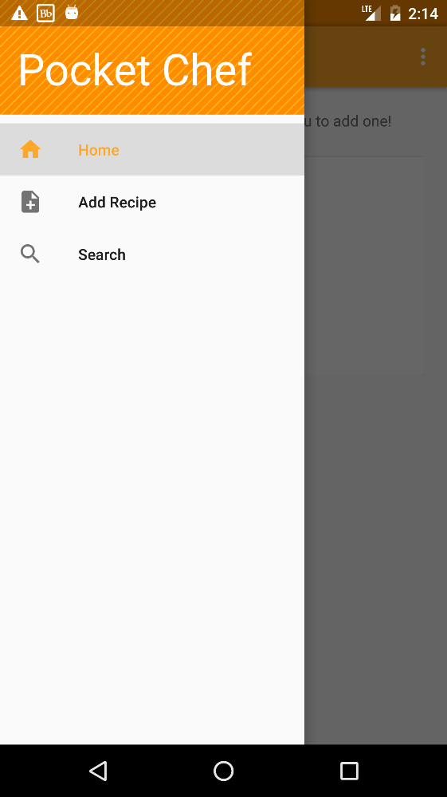

User Requirement
The Pocket Chef app shall hold and easily display recipes entered by the user
Future requirements include being
able to send and receive recipes
between devices, and being able to
modify app settings to assist with user
preferences and disabilities

